Slide 1


Slide 2
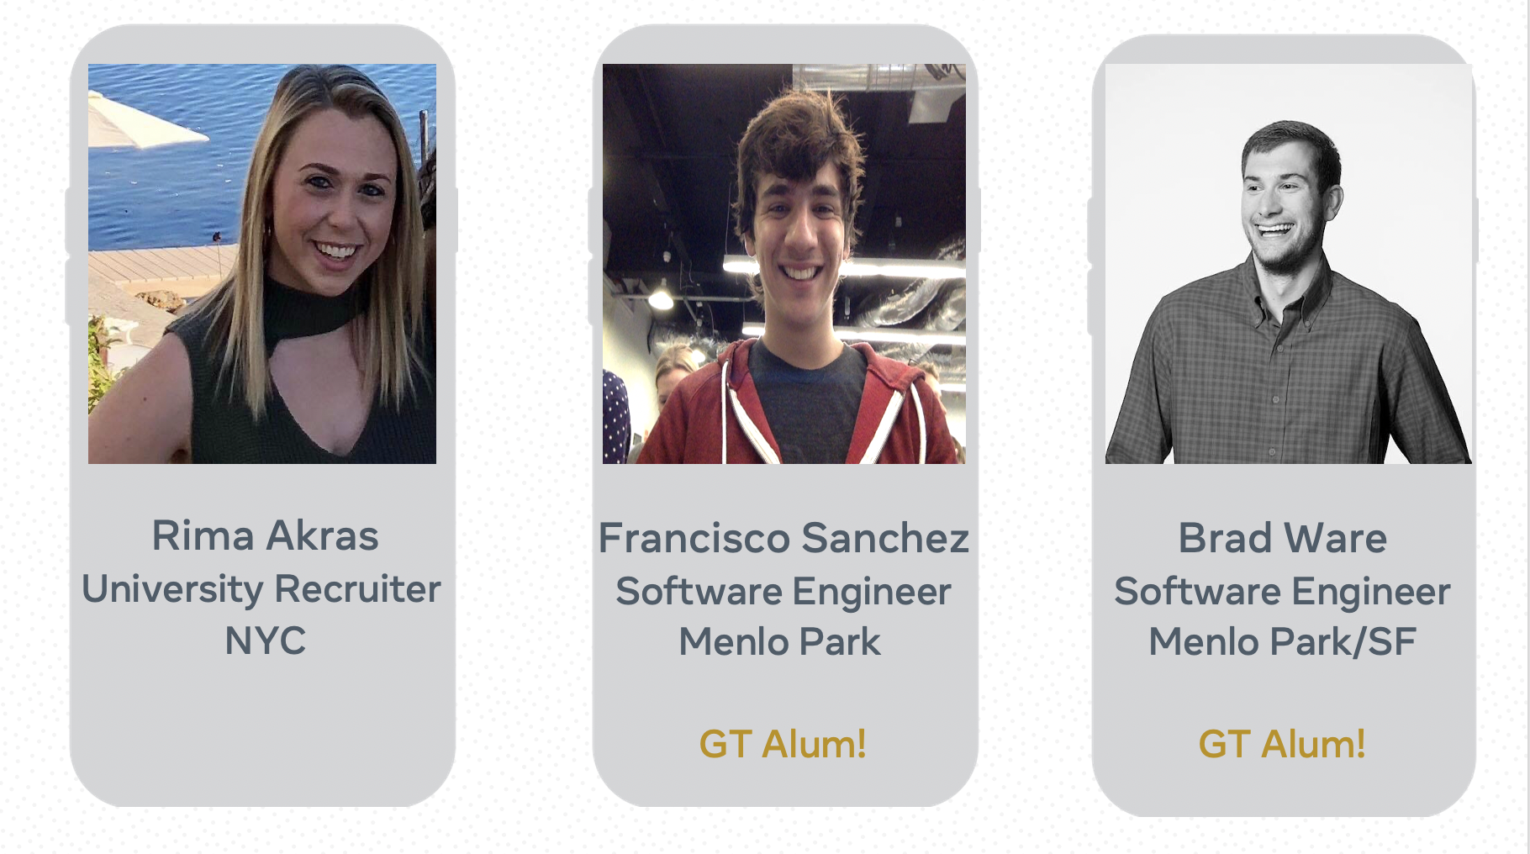

Slide 3
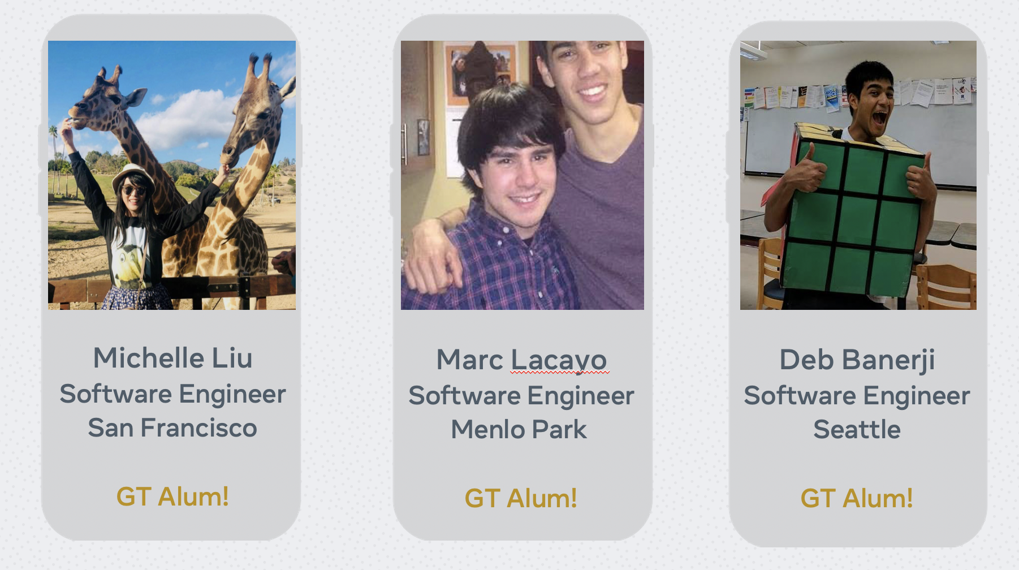

Slide 4
Interviewing Skills

Slide 5
Purpose
Ensure the company is a fit for you!
Candidate Selection
Evaluation

Slide 6
Types of Interviews
In Person
Phone
Virtual

Slide 7
Before the Interview

Slide 8
Research the Company
Strategic plans & mission/values
Company products & services
Employee reviews
Current job openings
Leadership

Slide 9
Plan Ahead
Practice! Practice! Practice!
Bring several copies of your resume!
Make sure to arrive 15 minutes early

Slide 10
Prepare Your Outfit
Business Professional or Business Casual?
You can always ask your contact.

Slide 11
The Technical Interview
Helps an employer evaluate your skills
Conducted on a whiteboard or laptop
Expect to be asked questions related to coursework, concepts (programming skills), and/or industry knowledge
Check out technical interviewing books from the Career Services office!

Slide 12
Behavioral Interviews
Evaluates the way a candidate thinks and feels, and provides an opportunity to learn about past internship experiences and projects
Be prepared to be surprised
Answer these questions using the STAR Method
Describe the Situation or Task
Discuss the Action you took
Explain the Result of that action

Slide 13
During the Interview

Slide 14
Things to Remember
The interview gives you a chance to see if the company is a good fit for YOU
Look around when you arrive –
What is the environment like?
Are people happy to be there?
Do desks have personal items on them?

Slide 15
Interview Etiquette
Shake hands firmly.
Make eye contact with your interviewer(s).
Smile!
Hygiene – no perfume/cologne, freshly laundered clothes
Use professional body language.
Thank them for the opportunity.

Slide 16
Dealing with a Bad Interviewer
Makes you wait forever after you show up on time
Asks illegal interview questions
Are rude conversationalists
Acts unprofessionally
Decide if you want to continue the interview. If not, politely excuse yourself

Slide 17
Illegal Interview Questions
Religion
Age
Ethnicity
Citizenship
Disability or Health
Marital Status
Children or Pregnancy Status
Sexual Orientation

Slide 18
Closing the Interview
Create a list of 3-5 questions for the interview
Think about questions you genuinely want to know the answer to
Never ask questions regarding time off or benefits

Slide 19
Questions for the Interviewer?
Team culture
Are there any opportunities for professional development or mentorship?
What is the most challenging aspect of working in this role/department?
What do you enjoy about working for the company?
What is a day in the life like for someone in this position?

Slide 20
After the Interview

Slide 21
Next Steps
Take a deep breath and relax, you did it!
Reflect on what you think went really well, and some things that you could have done better.
Send a Thank You email or handwritten note
Wait! Give the employer time to reach back out to you and continue your job search.

Slide 22
Travel Reimbursement
Save all receipts related to your travel to and from the interview
Stay in contact with the company if you have been offered travel reimbursement
Make sure to ask questions if you aren’t sure
Use travel reimbursement ethically

Slide 23
Reducing Anxiety
Mindfulness
Deep Breathing Strategies
Visual Imagery
Take a Break
Reframe Negative Self Talk
“I did terrible, there is no way they will call me back with an offer.”
Stress Reducing Apps
Headspace
Colorfy
Stop, Breath, and Think

Slide 24
Questions?

Slide 25
Contact Information
Jasmine Posey, LPC
Location: CCB 138
jasmine.posey@cc.gatech.edu
Drop In Hours:
Monday 9:00-11:00am
Alumni in Residence: Fridays
Schedule an appointment using Handshake!

Slide 26
https://b.gatech.edu/38GrkuU
Complete the Survey

